Slide 1

CS-M151B
Computer Systems Architecture
Blaise Tine
UCLA Computer Science

Slide 2

Attendance

Slide 3
Agenda
Out of order Processors

Slide 4
Processor Types (Recap)
Scalar CPU: process at most one instruction per cycle
Shortcomings: IPC<=1
SuperScalar CPU : process at most N instructions per cycle
Shortcomings: IPC rarely reach N
Why? Data dependencies
Out of Order CPU: process instructions out of order
Goal: Resolve data dependencies

Slide 5
Modern Processor Requirements
Fetching multiple instructions each cycle
Executing multiple instructions concurrently
Partitioned execute stage
Multiple functional units (e.g. ALU, FPU, LSU)
Variable-latency units
Commit instructions in order
Preserving external states

Slide 6
Modern Processor Pipeline
Three main stages: Issue, Execute, Commit
In-order
Out-of-order
In-order
Issue (ID)
Execute (EX, MEM, WB)
Commit
Fetch
Decode
ALU
LSU
Register File
Data Memory

Slide 7
Out of Order Execution
OoO Design Challenges?
How do we resolve data dependencies?
How do we handle pipeline hazards?
How do we preserve ordering for external states?
Notes:
Instr window = range of instructions to search

Slide 8
Register Renaming
Resolving Data dependencies
In-order
Out-of-order
In-order
Issue (ID)
Execute (EX, MEM, WB)
Retire
Fetch
Decode
ALU
LSU
Register File
Data Memory
Register
Renaming

Slide 9
Register Renaming Structures
ARF, PRF, and RAT
Architected
Register
File
ARF
“Outside” world sees the ARF
RAT
PRF
One PREG per instruction in-flight
Register
Alias
Table
Physical
Register
File
Notes:
Instr window = range of instructions to search

Slide 10
Register Renaming Summary
Advantages?
Eliminate WAR data dependencies (anti-dep)
Eliminate WAW data dependencies (output-dep)
Limitations
Doesn’t remove RAW data dependencies (true-dep)
Notes:
Instr window = range of instructions to search

Slide 11
Scoreboarding
Resolving RAW dependencies
In-order
Out-of-order
In-order
Issue (ID)
Execute (EX, MEM, WB)
Retire
Fetch
Decode
ALU
LSU
Register File
Data Memory
Register
Renaming
Scoreboad

Slide 12
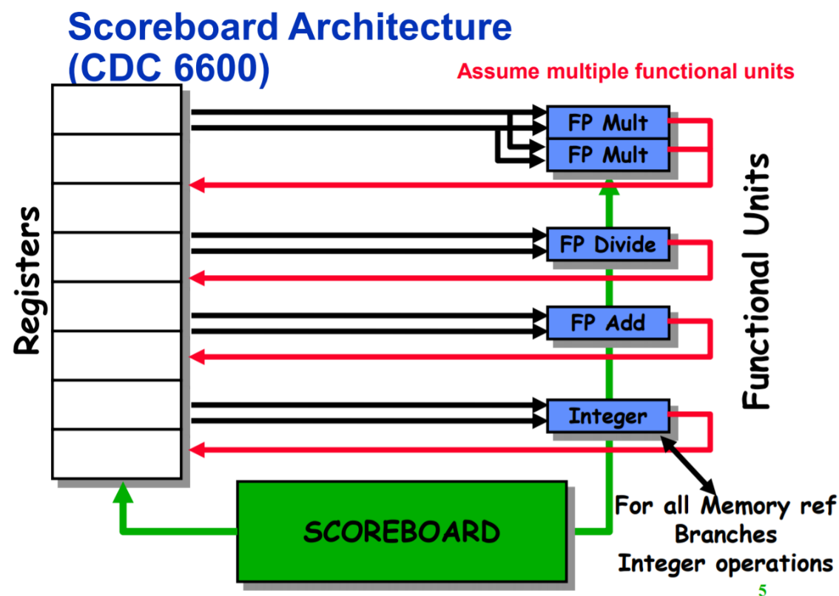
Scoreboarding
CDC6600’s scoreboard: first OOO processor!
1964 - Seymour Cray from CDC
https://hackmd.io/@a5180352/S1FFbP6pz?type=view

Slide 13
CDC6600 - Scoreboarding
Supporting multiple fixed-latency functional units
FP Mult x2
FP Div
FP Add
Integer
ALU
Branch
Mem
https://hackmd.io/@a5180352/S1FFbP6pz?type=view

Slide 14
CDC6600 – Four-Stages Pipeline
Issue
Register Operands
Execute
Writeback
https://hackmd.io/@a5180352/S1FFbP6pz?type=view

Slide 15
CDC6600 – Four-Stages Pipeline
Issue
Fetch next instruction
Wait for no hazards
Data hazards:
WAR: check if previous instruction is writing to any of my source operands
WAW: check if previous instruction is writing to my destination operand
Structural hazards: check if functional unit not available
https://hackmd.io/@a5180352/S1FFbP6pz?type=view

Slide 16
CDC6600 – Four-Stages Pipeline
Read Operands
Read register file
Not check is needed
https://hackmd.io/@a5180352/S1FFbP6pz?type=view

Slide 17
CDC6600 – Four-Stages Pipeline
Execute
Each functional unit execute its issued instruction
RAW data dependencies:
Wait until all source operands are available
https://hackmd.io/@a5180352/S1FFbP6pz?type=view

Slide 18
CDC6600 – Four-Stages Pipeline
Writeback
Update register file
Ensuring program ordering
Wait until all prior instructions have completed before serving current one using Instruction Status state
https://hackmd.io/@a5180352/S1FFbP6pz?type=view

Slide 19
CDC6600 – Scoreboard States
Instruction Status: which pipeline stage it is in
Functional Units (FU) status
Busy - is busy
Op - operation to execute
Fi - destination register id
Fj, Fk - source register ids,
Qj, Qk - FUs producing source registers
Rj, Rk - FUs producing source registers are ready
Register result status: which FU is producing the register
https://hackmd.io/@a5180352/S1FFbP6pz?type=view

Slide 20
CDC6600 – Scoreboard Example
LD F6 34 R2
LD F2 45 R3
FMULT F0 F2 F4
FADD F8 F6 F2
FDIV F10 F0 F6
Busy | Op | Fi | Fj | Fk | Qj | Qk | Rj | Rk
INT FM1 FM2 FA FD
IS | RO | EX | WB
F0 | F1 | F2 | F3 | F4 | F5 | F6 | F7 | F8 | F9 | F10
https://hackmd.io/@a5180352/S1FFbP6pz?type=view

Slide 21
CDC6600 – Scoreboard Example
Cycle1
Busy | Op | Fi | Fj | Fk | Qj | Qk | Rj | Rk
Y | LD | F6 |  | R2 |  |  |  | Y
INT FM1 FM2 FA FD
LD F6 34 R2
LD F2 45 R3
FMULT F0 F2 F4
FADD F8 F6 F2
FDIV F10 F0 F6
IS | RO | EX | WB
Y
F0 | F1 | F2 | F3 | F4 | F5 | F6 | F7 | F8 | F9 | F10
 |  |  |  |  |  | INT
https://hackmd.io/@a5180352/S1FFbP6pz?type=view

Slide 22
CDC6600 – Scoreboard Example
Cycle2
LD F6 34 R2
LD F2 45 R3
FMULT F0 F2 F4
FADD F8 F6 F2
FDIV F10 F0 F6
Busy | Op | Fi | Fj | Fk | Qj | Qk | Rj | Rk
Y | LD | F6 |  | R2 |  |  |  | Y
INT FM1 FM2 FA FD
IS | RO | EX | WB
Y | Y
F0 | F1 | F2 | F3 | F4 | F5 | F6 | F7 | F8 | F9 | F10
 |  |  |  |  |  | INT
https://hackmd.io/@a5180352/S1FFbP6pz?type=view

Slide 23
CDC6600 – Scoreboard Example
Cycle3
LD F6 34 R2
LD F2 45 R3
FMULT F0 F2 F4
FADD F8 F6 F2
FDIV F10 F0 F6
Busy | Op | Fi | Fj | Fk | Qj | Qk | Rj | Rk
Y | LD | F6 |  | R2 |  |  |  | Y
INT FM1 FM2 FA FD
IS | RO | EX | WB
Y | Y | Y
F0 | F1 | F2 | F3 | F4 | F5 | F6 | F7 | F8 | F9 | F10
 |  |  |  |  |  | INT
https://hackmd.io/@a5180352/S1FFbP6pz?type=view

Slide 24
CDC6600 – Scoreboard Example
Cycle4
LD F6 34 R2
LD F2 45 R3
FMULT F0 F2 F4
FADD F8 F6 F2
FDIV F10 F0 F6
Busy | Op | Fi | Fj | Fk | Qj | Qk | Rj | Rk
INT FM1 FM2 FA FD
IS | RO | EX | WB
Y | Y | Y | Y
F0 | F1 | F2 | F3 | F4 | F5 | F6 | F7 | F8 | F9 | F10
https://hackmd.io/@a5180352/S1FFbP6pz?type=view

Slide 25
CDC6600 – Scoreboard Example
Cycle5
LD F6 34 R2
LD F2 45 R3
FMULT F0 F2 F4
FADD F8 F6 F2
FDIV F10 F0 F6
Busy | Op | Fi | Fj | Fk | Qj | Qk | Rj | Rk
Y | LD | F2 |  | R3 |  |  |  | Y
INT FM1 FM2 FA FD
IS | RO | EX | WB
Y
F0 | F1 | F2 | F3 | F4 | F5 | F6 | F7 | F8 | F9 | F10
 |  | INT
https://hackmd.io/@a5180352/S1FFbP6pz?type=view

Slide 26
CDC6600 – Scoreboard Example
Cycle6
LD F6 34 R2
LD F2 45 R3
FMUL F0 F2 F4
FADD F8 F6 F2
FDIV F10 F0 F6
Busy | Op | Fi | Fj | Fk | Qj | Qk | Rj | Rk
Y | LD | F2 |  | R3 |  |  |  | Y
Y | FMUL | F0 | F2 | F4 | INT |  | N | Y
INT FM1 FM2 FA FD
IS | RO | EX | WB
Y | Y
Y
F0 | F1 | F2 | F3 | F4 | F5 | F6 | F7 | F8 | F9 | F10
FM1 |  | INT
https://hackmd.io/@a5180352/S1FFbP6pz?type=view

Slide 27
CDC6600 – Scoreboard Example
Cycle7
LD F6 34 R2
LD F2 45 R3
FMUL F0 F2 F4
FADD F8 F6 F2
FDIV F10 F0 F6
Busy | Op | Fi | Fj | Fk | Qj | Qk | Rj | Rk
Y | LD | F2 |  | R3 |  |  |  | Y
Y | FMUL | F0 | F2 | F4 | INT |  | N | Y
Y | FADD | F8 | F6 | F2 |  | INT | Y | N
INT FM1 FM2 FA FD
IS | RO | EX | WB
Y | Y | Y
Y
Y
F0 | F1 | F2 | F3 | F4 | F5 | F6 | F7 | F8 | F9 | F10
FM1 |  | INT |  |  |  |  |  | FA
https://hackmd.io/@a5180352/S1FFbP6pz?type=view

Slide 28
CDC6600 – Scoreboard Example
Cycle8
LD F6 34 R2
LD F2 45 R3
FMUL F0 F2 F4
FADD F8 F6 F2
FDIV F10 F0 F6
Busy | Op | Fi | Fj | Fk | Qj | Qk | Rj | Rk
Y | LD | F2 |  | R3 |  |  |  | Y
Y | FMUL | F0 | F2 | F4 | INT |  | Y | Y
Y | FADD | F8 | F6 | F2 |  | INT | Y | Y
Y | FDIV | F10 | F0 | F6 | FM1 |  | N | Y
INT FM1 FM2 FA FD
IS | RO | EX | WB
Y | Y | Y | Y
Y
Y
Y
F0 | F1 | F2 | F3 | F4 | F5 | F6 | F7 | F8 | F9 | F10
FM1 |  | INT |  |  |  |  |  | FA |  | FD
https://hackmd.io/@a5180352/S1FFbP6pz?type=view

Slide 29
CDC6600 – Limitations
No register renaming
Detect WAR and WAW but stalls
https://hackmd.io/@a5180352/S1FFbP6pz?type=view

Slide 30
Dynamic Scheduling
Tomasulo’s Algorithm
Used in IBM 360/91 (in the 60s)
Tracks when operands are available to satisfy data dependences
Removes name dependences through register renaming
Very similar to what is used today
Almost all modern high-performance processors use a derivative of Tomasulo’s… much of the terminology survives to today.
https://hackmd.io/@a5180352/S1FFbP6pz?type=view

Slide 31
Dynamic Scheduling
Tomasulo’s Algorithm
Used in IBM 360/91 (in the 60s)
Tracks when operands are available to satisfy data dependences
Removes name dependences through register renaming
Very similar to what is used today
Almost all modern high-performance processors use a derivative of Tomasulo’s… much of the terminology survives to today.
https://hackmd.io/@a5180352/S1FFbP6pz?type=view

Slide 32
Dynamic Scheduling
Instruction
Queue
Reservation Stations
LD/ST Buffers
Common data Bus
https://hackmd.io/@a5180352/S1FFbP6pz?type=view

Slide 33
Three Stages of Tomasulo Algorithm
Issue—get instruction from Instruction Queue
Execution—operate on operands (EX)
Write result—finish execution (WB)
https://hackmd.io/@a5180352/S1FFbP6pz?type=view

Slide 34
Issue Stage
Get next instruction from instruction queue.
Find a free reservation station for it (if none are free, stall until one is)
Read operands that are in the registers
If the operand is not in the register, find which reservation station will produce it
In effect, this step renames registers (reservation station IDs are “temporary” names)
https://hackmd.io/@a5180352/S1FFbP6pz?type=view

Slide 35
Issue Stage
Instruction Buffers
To-Do list (from last slide):
Get next inst from IB’s
Find free reservation station
Read operands from RF
Record source of other operands
Update source mapping (RAT)
Reg File
0.
F2 = F4 + F1
F1
3.141593
1.
F1 = F2 / F3
F2
-1.00000
2.
F4 = F1 – F2
F3
2.718282
3.
F1 = F2 + F3
F4
0.707107
RAT
F1
0
A1 (α)
F2=F4+F1
0.7071
3.14
C1 (δ)
F1 = F2/F3
α(A1)
2.718282
F2
α
A2 (β)
C2 (ε)
F3
0
A3 (χ)
F4
0
Adder
Reservation stations
FP-Cmplx
https://hackmd.io/@a5180352/S1FFbP6pz?type=view

Slide 36
Execute
Monitor results as they are produced
Broadcast result to all reservation stations with operands waiting for it (via common data bus)
When all operands available for an instruction, it is ready for execution.
When multiple instructions in RS are ready?
Pick any
Except for load/store (must be ordered to avoid memory hazards)

Slide 37
Execute
0.
F2 = F4 + F1
To-Do list (from last slide):
Monitor results from ALUs
Capture matching operands
Compete for ALUs
1.
F1 = F2 / F3
2.
F4 = F1 – F2
3.
F1 = F2 + F3
F2=F4+F1
(α) 3.8487
A1 (α)
C1 (δ)
F1=F2/F3
(α)
2.718
3.8487
A2 (β)
F4=F1-F2
(δ)
(α)
C2 (ε)
3.8487
A3 (χ)
F1=F2+F3
(α)
2.718
3.8487
Adder
FP-Cmplx

Slide 38
Execute
Common heuristic: oldest first
You can do whatever: it only
affects performance, not correctness
F2=F4+F1
(α) 3.8487
A1 (α)
F1=F2/F3
(α)
C1 (δ)
3.8487
2.718
3.
F1 = F2 + F3
F4=F3-F2
2.718
(α)
A2 (β)
3.8487
C2 (ε)
2.
F4 = F3 – F2
A3 (χ)
F1=F2+F3
(α)
3.8487
2.718
1.
F1 = F2 / F3
0.
F2 = F4 + F1
Adder
FP-Cmplx

Slide 39
Write Result
When result is computed, make it available on the “common data bus” (CDB), where waiting reservation stations can pick it up
Stores write to memory
Result stored in the register file
This step frees the reservation station
For our register renaming, this recycles the temporary name (future instructions can again find the value in the actual register, until it is renamed again)

Slide 40
0.
F2 = F4 + F1
To-Do list (from last slide):
Broadcast on CDB
Writeback to RF
Update Mapping
Free reservation station
Only update RAT
(and RF) if RAT still
contains your mapping!
Write Result
1.
F1 = F2 / F3
2.
F4 = F1 – F2
3.
F1 = F2 + F3
Reg File
F1
3.141593
-1.00000
F2
3.8486994
A1 (α)
F2=F4+F1
0.7071
3.14
F1=F2/F3
2.718
(α)
C1 (δ)
3.8487
F3
2.718282
F4=F1-F2
(δ)
(α)
A2 (β)
3.8487
C2 (ε)
F4
0.707107
A3 (χ)
F1=F2+F3
(α)
3.8487
2.718
RAT
F1
X
0
χ
α
F2
0
Adder
FP-Cmplx
(α) 0.7071+3.14
F3
0
F4
β

Slide 41
Tomasulo’s Algorithm: Load/Store
The reservation stations take care of dependencies through registers.
Dependences also possible through memory
Loads and stores not reordered in original IBM 360
We’ll talk about how to do load-store reordering later

Slide 42
Tomasulo Drawbacks
Many associative stores (CDB) at high speed
Performance limited by Common Data Bus
Multiple CDBs => more FU logic for parallel associative stores

Slide 43
Q&A

Slide 44
Acknowledgement
This course is partly inspired and use materials from the following courses created by my colleagues:
ECE-M1126C: Nader Sehatbakhsh @ UCLA
CS3220: Hyesoon Kim @ gatech

